Slide 1
Result of customer buying behavior
By: Prajukta Dey

Slide 2
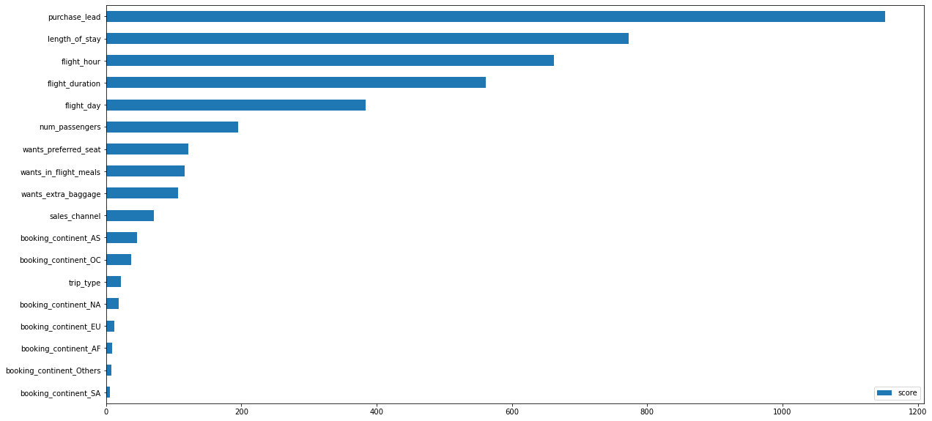
Data Analysis and Prediction
From our feature importance from the ML model we made, we know that the influencing factors for customers to complete their booking are [urchase_lead (the time gap between the order tome and flight) and length_of_stay(hw long the customer will occupy the destination).

